Slide 1

Bell Work:
Solve:
$$x^{2}+x=12$$

Slide 2
From Last Time…
New Material:
Page 229 #1-6, 9-17 (odd), 31, 44
Mixed Review:
Page 231 # 67(use a matrix), 73

Slide 3
ALGEBRA 3
Day 37

Slide 4
4.7 The Quadratic Formula Quadratic Formula: another method used to solve ANY quadratic equation of the form: (ax² + bx + c = 0)

Slide 5
The Quadratic Formula;
The solutions of the quadratic equation
ax² + bx + c = 0 are:
-- Can be used to solve any quadratic equation (instead of factoring or graphing)
--Must be in standard form; ax² + bx + c = 0

Slide 6
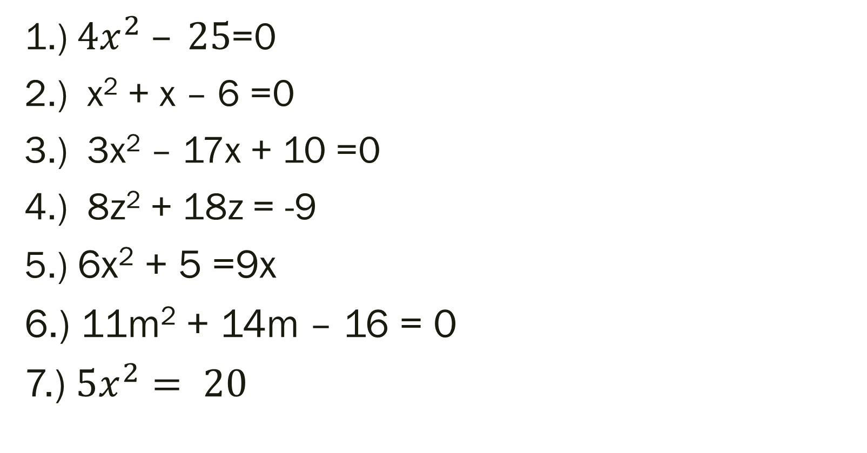
Solve:
1.) $4x^{2} – 25$=0
2.) x² + x – 6 =0
3.) 3x² – 17x + 10 =0
4.) 8z² + 18z = -9
5.) 6x² + 5 =9x
6.) 11m² + 14m – 16 = 0
7.) $5x^{2}= 20$

Slide 7
4.8 Complex Numbers
Objective: Identify, and Add, Subtract, Multiply and Divide with Imaginary Numbers

Slide 8
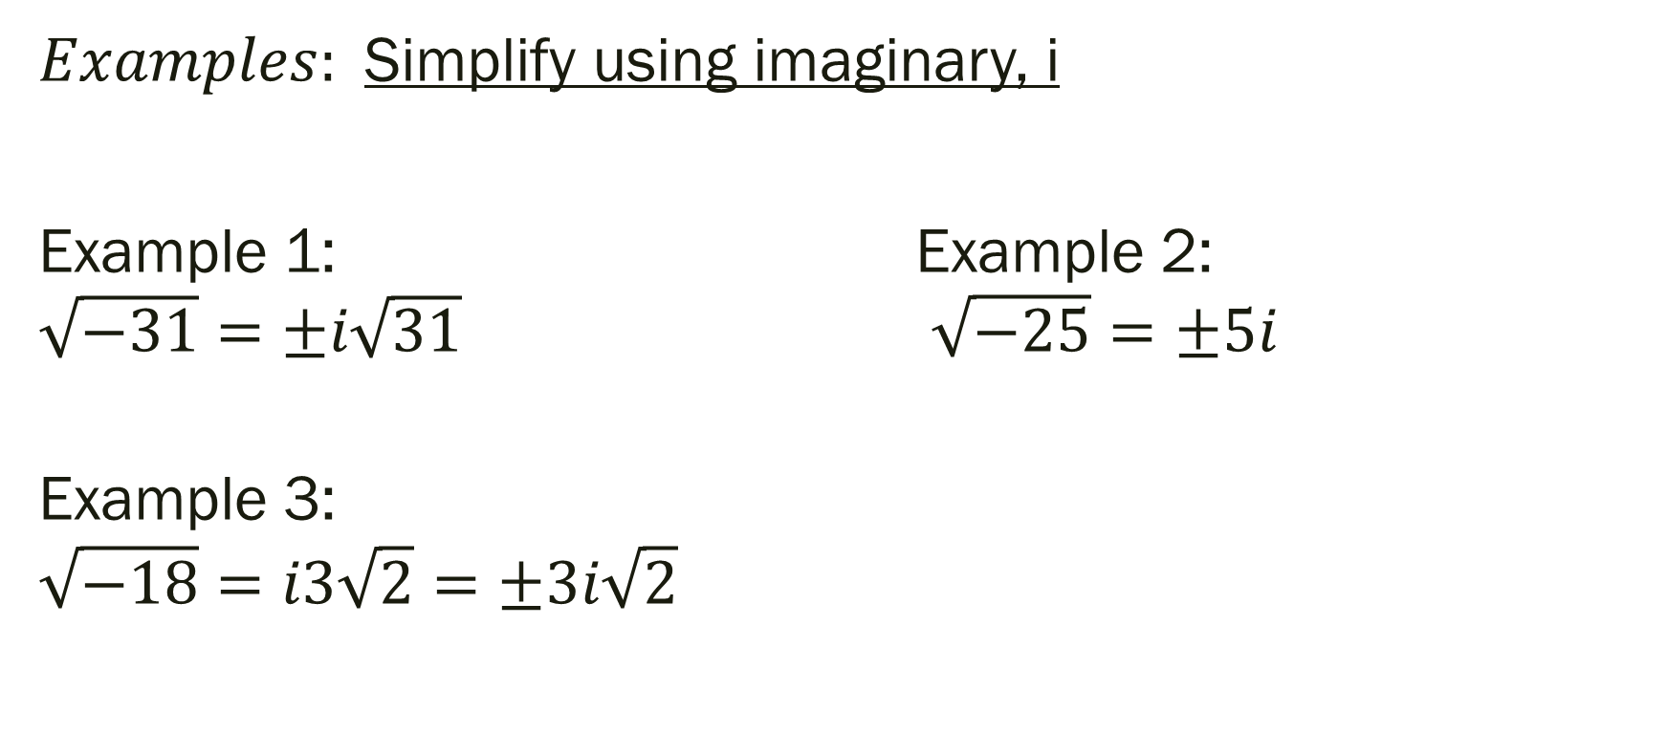
Imaginary Unit: i, defined as
or, i² = -1
$Examples:$Simplify using imaginary, i
Example 1: Example 2: $\sqrt{−31}=±i\sqrt{31}$ $\sqrt{−25}=±5i$
Example 3:
$$\sqrt{−18}=i3\sqrt{2}=±3i\sqrt{2}$$

Slide 9
Adding and Subtracting
Sum of Complex Numbers:
(a + bi) + (c + di) = (a + c) + (b + d)i
Difference of Complex Numbers:
(a + bi) – (c + di) = (a – c) + (b – d)i

Slide 10
Examples:
(4 – i) + (3 + 2i) (7 – 5i) – (1 – 5i)
(4 + 3i) – (-2 + 4i) (1 + 5i) + (6 – 2i)

Slide 11
Solutions:
4 – i) + (3 + 2i) (7 – 5i) – (1 – 5i)
(4+3)+(-1+2)i (7-1)+(-5+5)i
7+i 6+0i=6
(4 + 3i) – (-2 + 4i) (1 + 5i) + (6 – 2i)
(4+2)+(3-4)i (1+6)+(5-2)i
6-i 7+3

Slide 12
Multiplying Complex Numbers; 1) Use distributive or FOIL methods 2) Simplify (combine like terms and use i² = -1) 3) Put into Standard Form (a + bi)
Examples:
5i(-2 + i) (7 – 4i)(-1 + 2i)

Slide 13
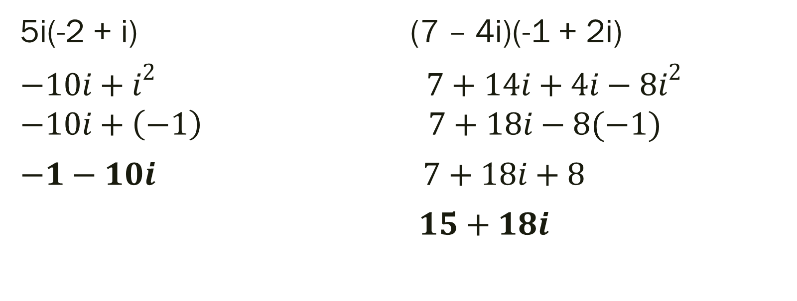
Solutions
5i(-2 + i) (7 – 4i)(-1 + 2i)
${−10i+i}^{2}$ ${7+14i+4i−8i}^{2}$
$$−10i+\left(−1\right) 7+18i−8(−1)$$
$−1−10i$ $7+18i+8$
$15+18i$

Slide 14
Solving Quadratics Equations with Complex Solutions
1) Isolate the squared term on one side of the equation
2) Square root both sides
3) Substitute i = √-1 into equation and simplify radical
4) Write solution in Standard Form (a + bi)

Slide 15

Examples:
1.) $\text{x}\text{2}\text{ = −9 }$
2.) $\text{2}\text{x}\text{2}\text{ + 3}\text{x}\text{ = −13}$
3.) $\text{3}\text{x}\text{2}\text{ + 10 = −26 }$
4.) $\text{4}\text{x}\text{2} \text{+6}\text{ = }$5x

Slide 16
For Next Time
New Material:
Page 244 #1–7, 15–21 (odd), 38
Page 253 #1–6, 9–33(odd), 39–43(odd), 48

